Slide 1
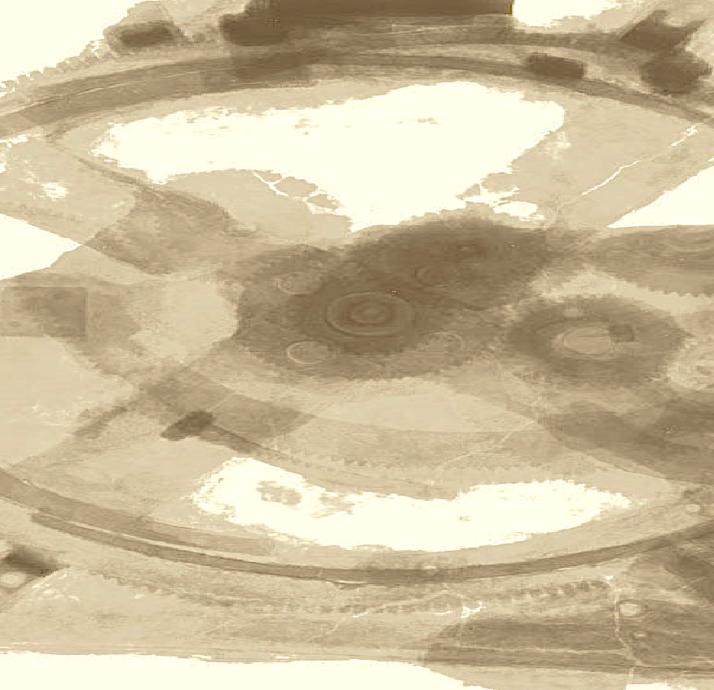

Drops of LTSpice
How to use Switches?

Slide 2
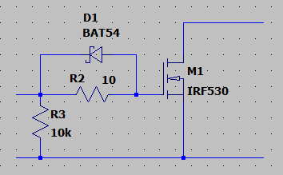
We often need switches in our circuits.
However, sometimes it's annoying to have to deal with calculations and values just for a proof of concept.

Slide 3
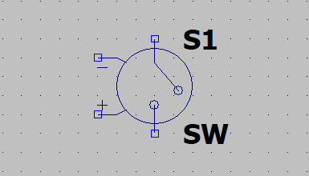
LTSpice provides a perfect component for this.
The Voltage Controlled Switch.
Let's see how to use it.

Slide 4
The switch opens and closes depending on the voltage at the control terminals.
You need to set a directive for your switch.

Slide 5
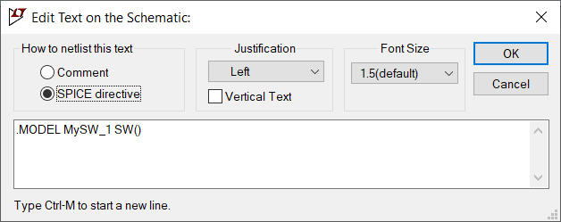
This is the simplest directive.
Note that it has the name we defined for the switch, in SW() with an empty parameter.

Slide 6
LTSpice will assume default values.
Name | Description | Default Values
Vt | Threshold voltage | 0.0 V
Vh | Hysteresis voltage | 0.0 V
Ron | On resistance | 1.0 Ω
Roff | Off resistance | 1.0 GΩ
Lser | Series inductance | 0.0 H
Vser | Series voltage | 0.0 V
Ilimit | Current limit | Infinite
In this case, any positive voltage will close the switch.

Slide 7
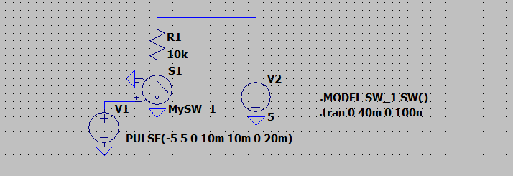
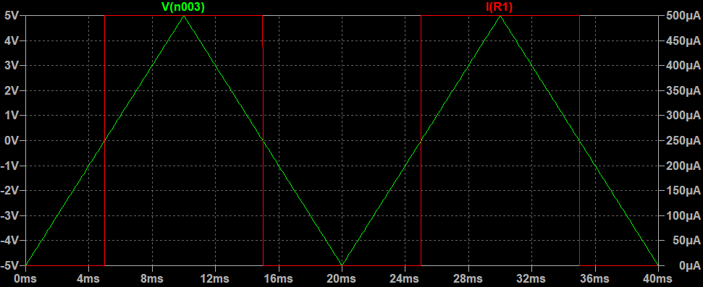
And out tests shows that any positive voltage closes the switch.

Slide 8
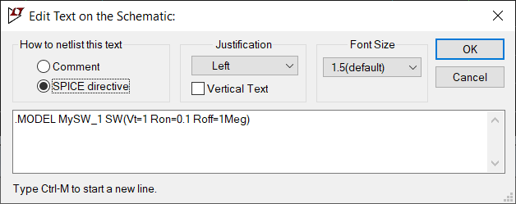
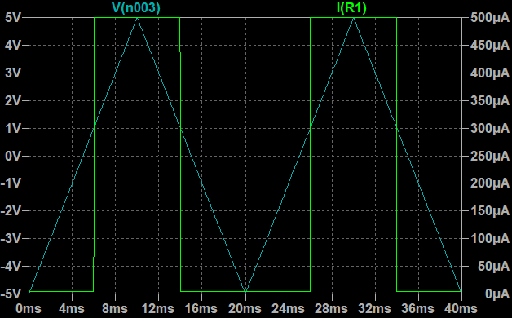
We can also set a different threshold voltage and resistances by changing the directive parameters.
Now, the threshold is 1V.

Slide 9
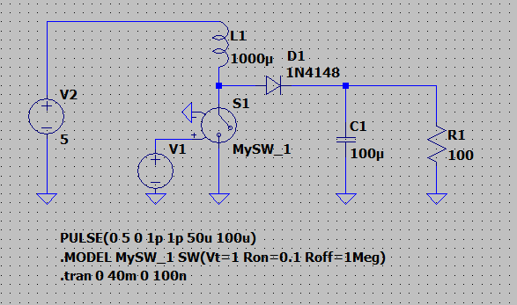
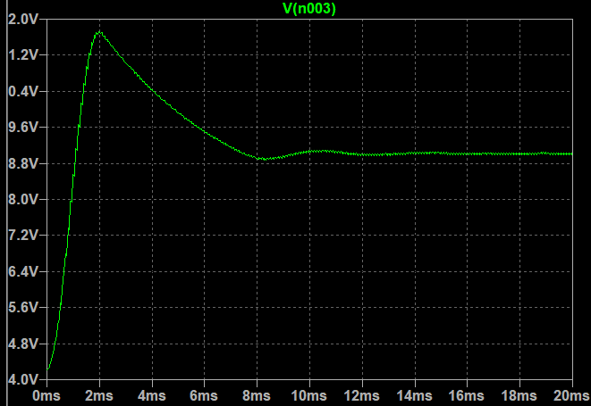
And you can easily use it instead of a transistor, for example.
Francesco Sacco
linkedin.com/in/saccofrancesco

